Slide 1


Final Project: MGMT 586
Lending Club Loan Defaulters’ Prediction
Notes:
Team introduction
Business problem + what we are trying to solve
Data description
Data visualization + exploratory data analysis + insights
Data cleaning
Model Building & Testing ANNs
Recommendations & Way Forward

Slide 2





Team 6
Usama Ather
Mayank Jha
Prerak Patel
Sandeep Mukhopadhyay

Slide 3


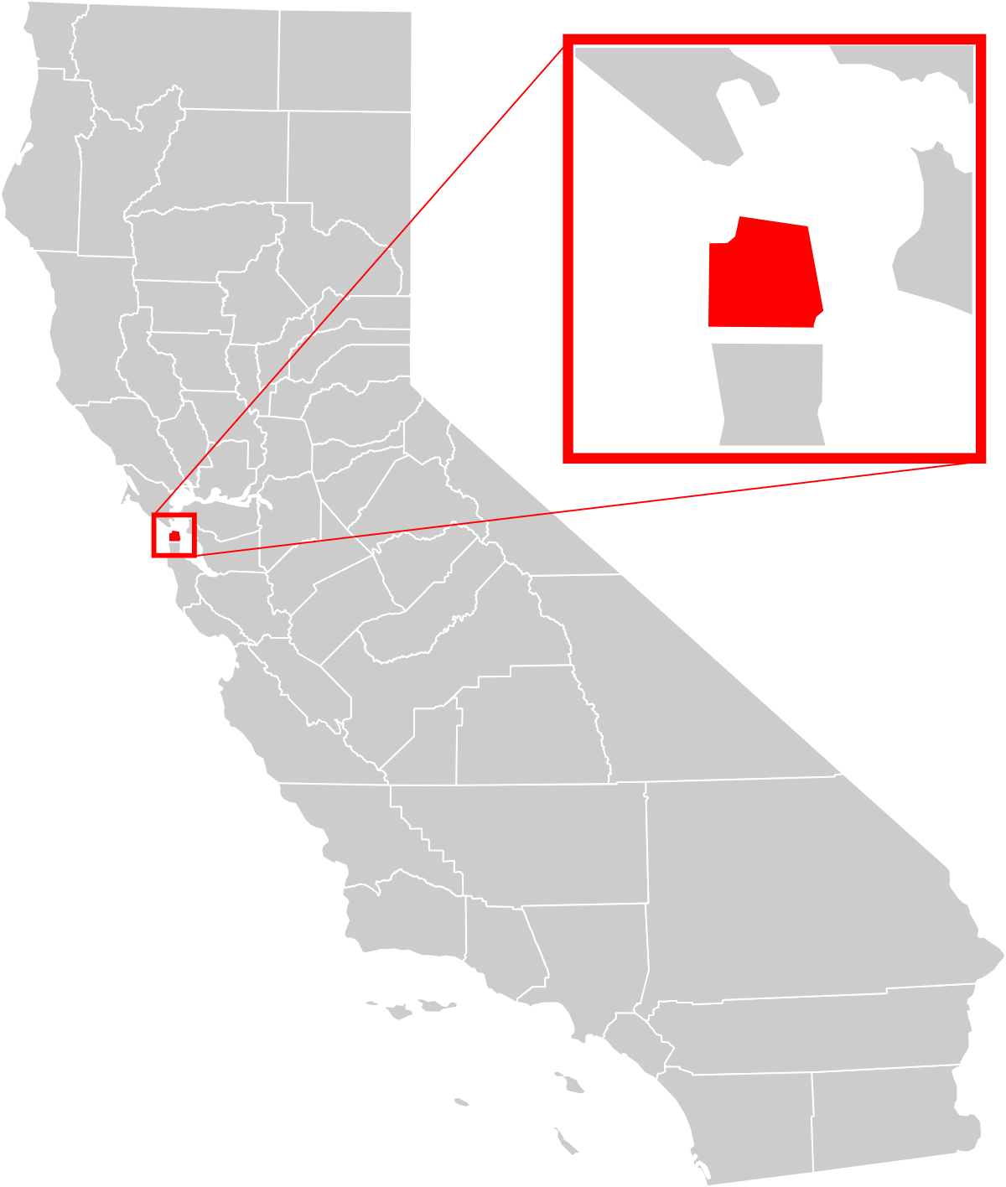

Company Introduction
Scope of the Project
Company Profile:
World’s largest peer-to-peer lending company based in San Francisco, USA
First peer-to-peer lender to register its offerings with Securities and Exchange Commission (SEC)
Risk Analytics in banking & financial services
Applying Machine Learning to real-world business problems
Notes:
We are dealing with a classification problem here

Slide 4
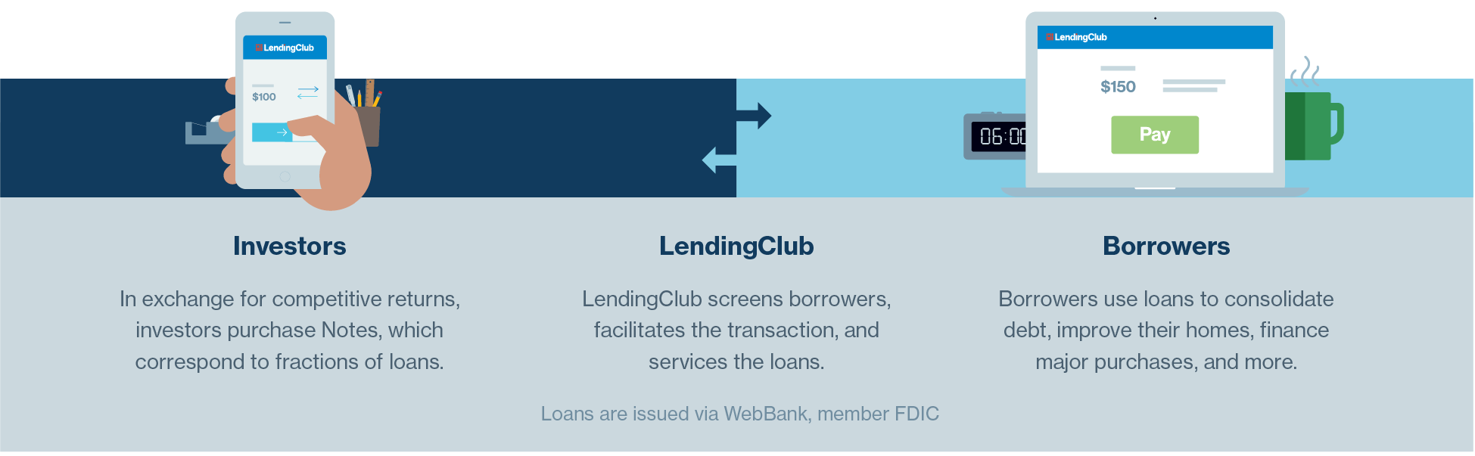



Business Understanding & Objectives
Business Objectives
Minimize Credit Loss
Understand Driving Factors Behind Loan Default
Maximize Profit

Slide 5
Data Description
Columns | Description
loan_amnt | The listed amount of the loan applied for by the borrower. If at some point in time, the credit department reduces the loan amount, then it will be reflected in this value.
term | The number of payments on the loan. Values are in months and can be either 36 or 60.
int_rate | Interest Rate on the loan
installment | The monthly payment owed by the borrower if the loan is approved.
home_ownership | The home ownership status provided by the Borrower during registration or obtained from the credit report. Values used are: Rent, Own, Mortgage and Other
annual_inc | The self-reported annual income provided by the borrower.
loan_status | Current status of the loan
dti | A ratio calculated using the borrower’s total monthly debt payments on the total debt obligations, excluding mortgage and the requested LendingClub loan, divided by the borrower’s self-reported monthly income.
open_acc | The number of open credit lines in the borrower's credit file.
pub_rec | Number of derogatory public records
total_acc | The total number of credit lines currently in the borrower's credit file
mort_acc | Number of mortgage accounts on the applicant's file.
pub_rec_bankruptcies | Number of public record bankruptcies

Slide 6
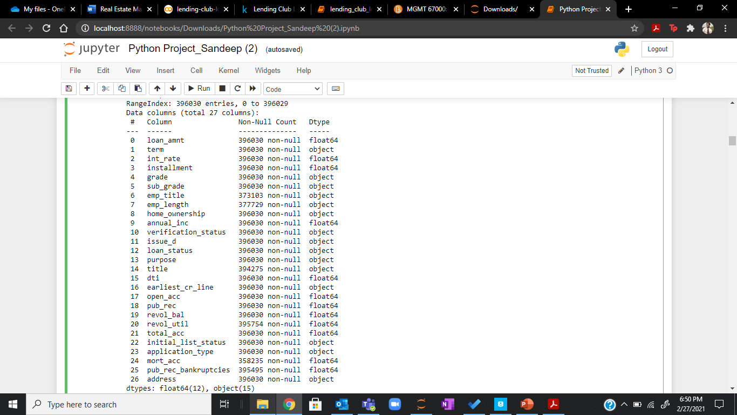
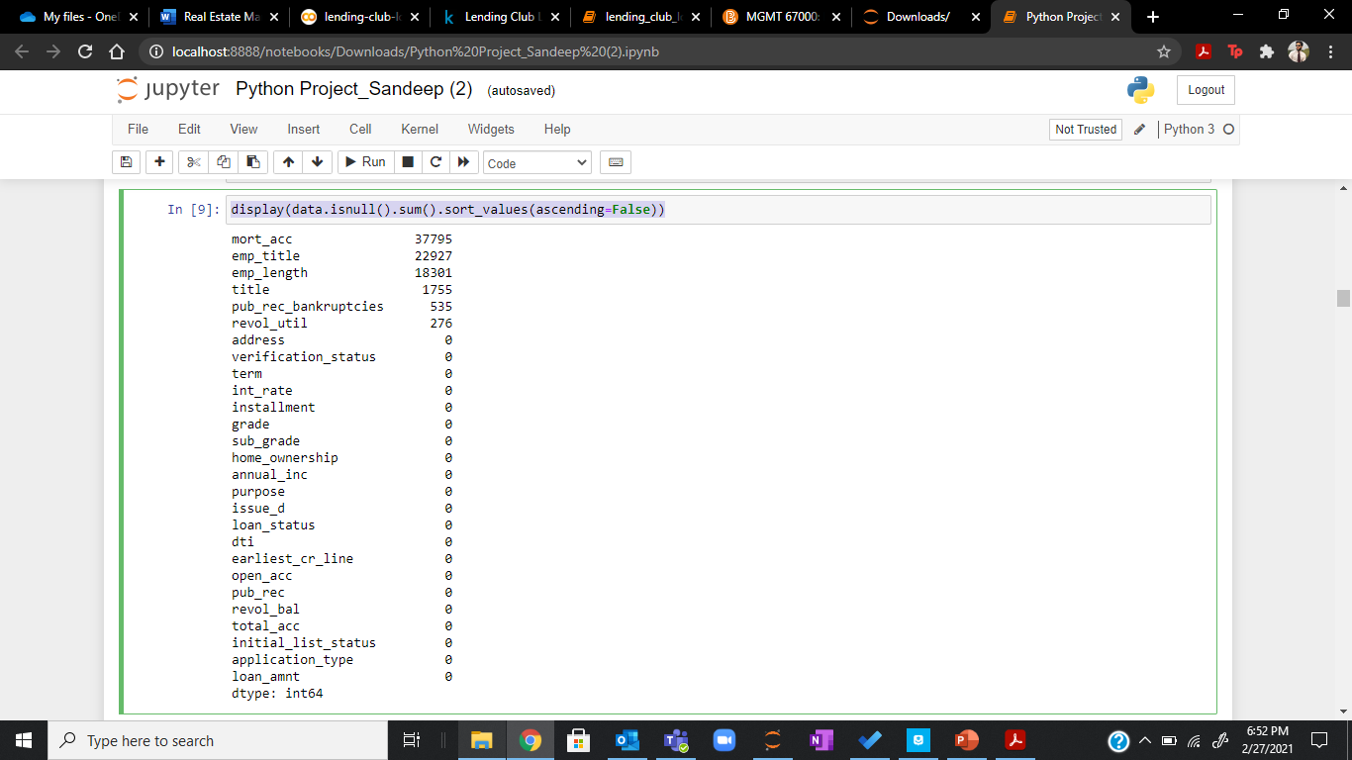
Exploratory Data Analysis
train.info()
display(train.isnull().sum().sort_values(ascending=False))
Notes:
We are dealing with both categorical and numerical features

Slide 7
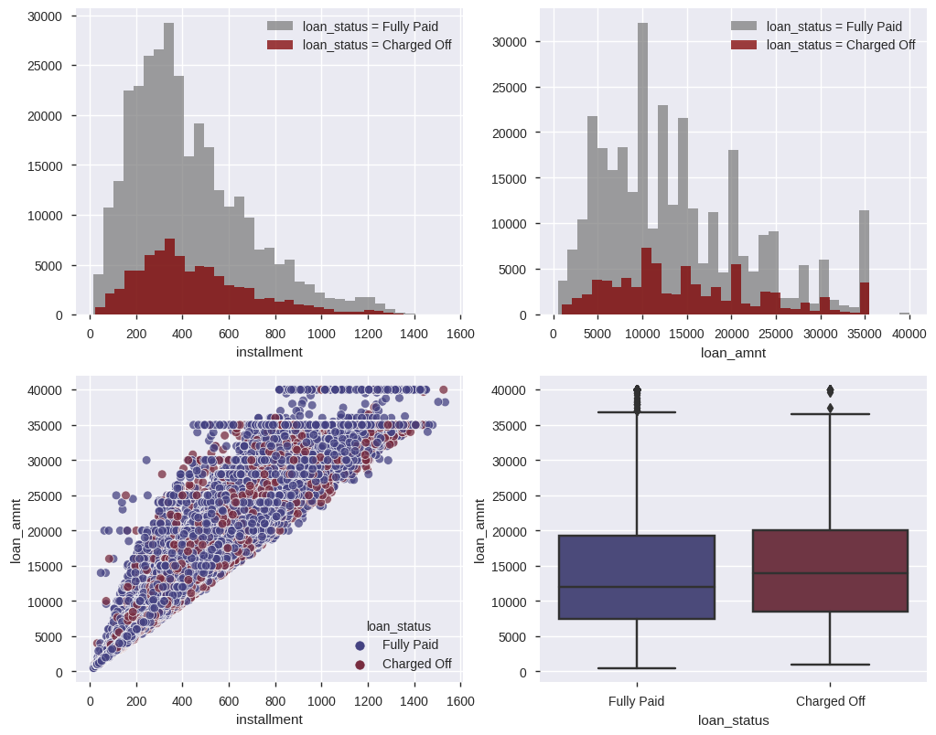
Exploratory Data Analysis
Insights
Relative to loan status, both installment & loan amount are fairly distributed amongst the values
Median loan amount for defaulters is higher as compared to non-defaulters

Slide 8
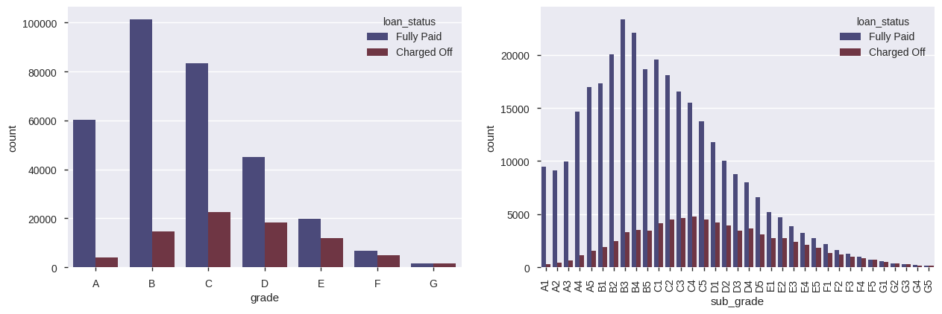
Exploratory Data Analysis
Insights
Grades F & G show higher probability of loan default
F5 – G5 call for special concern within these grades for Lending Club
Notes:
Explain grade

Slide 9
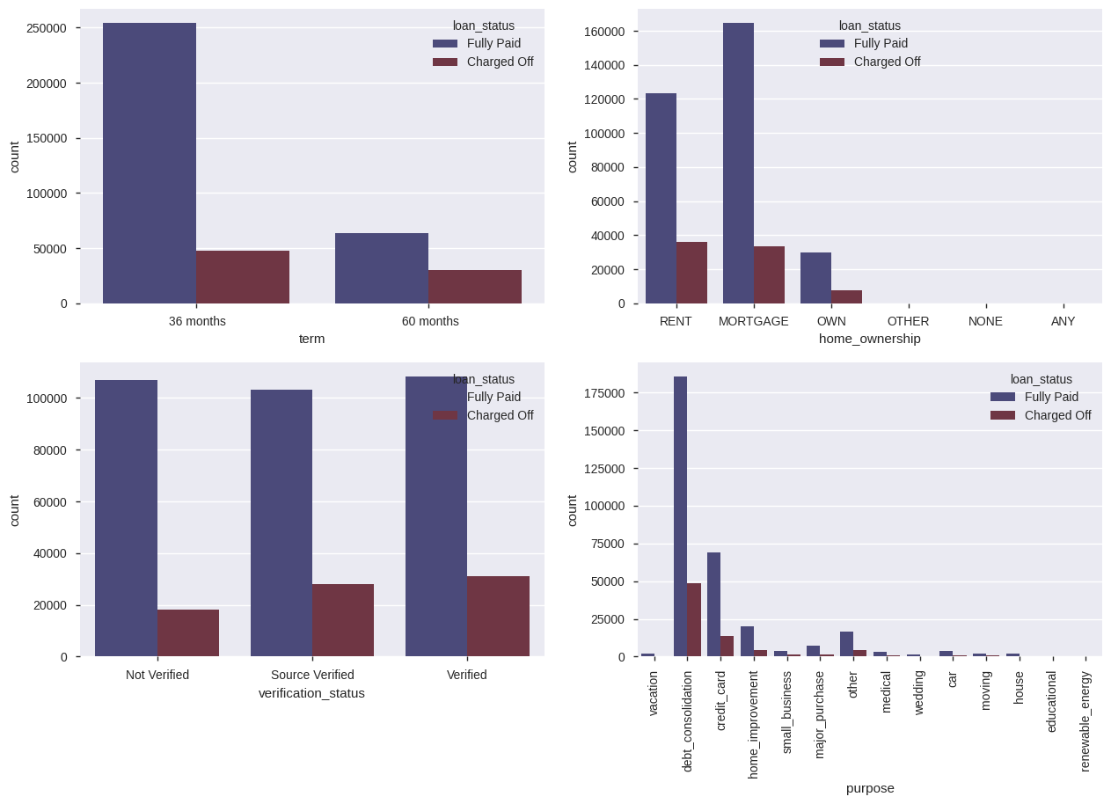
Exploratory Data Analysis
Insights
Longer term loan is more likely to default
Counter intuitively people with no verification have slightly less likelihood of loan default
Debt consolidation seems to be the most common reason for loan availing

Slide 10
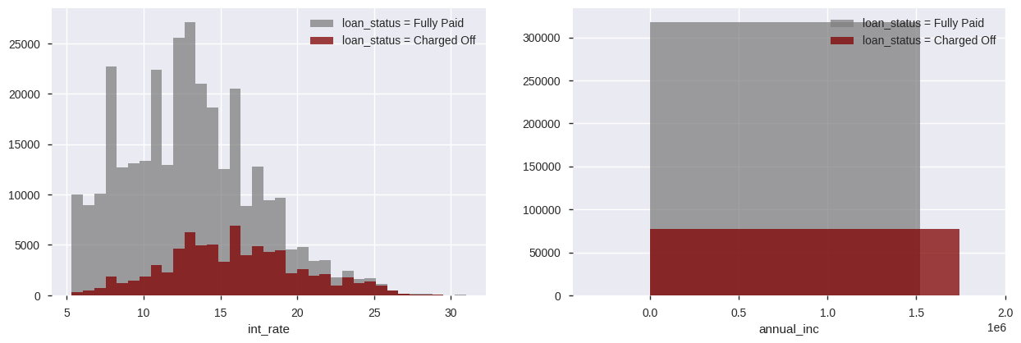
Exploratory Data Analysis
Insights
Proportion of default becomes higher as the interest rate increases
A continuous distribution is observed for annual income
Notes:
People with pooor credit history

Slide 11
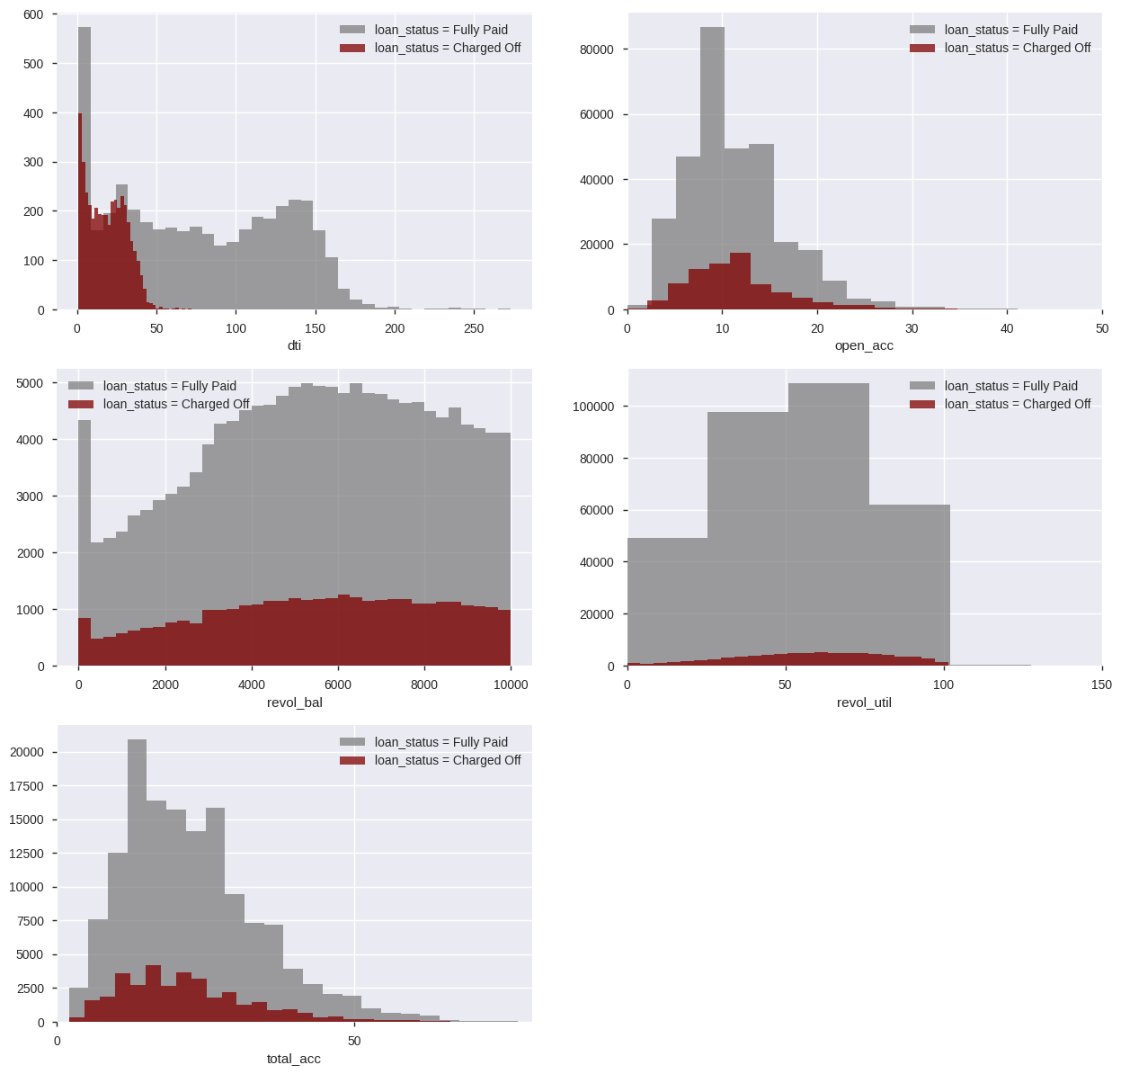
Exploratory Data Analysis
Insights
Smaller the dti, more chances of defaulting on the repayment
Total accounts follow a normal distribution but the mean for accounts which have defaulted is much lesser than the mean for accounts that have fully paid

Slide 12
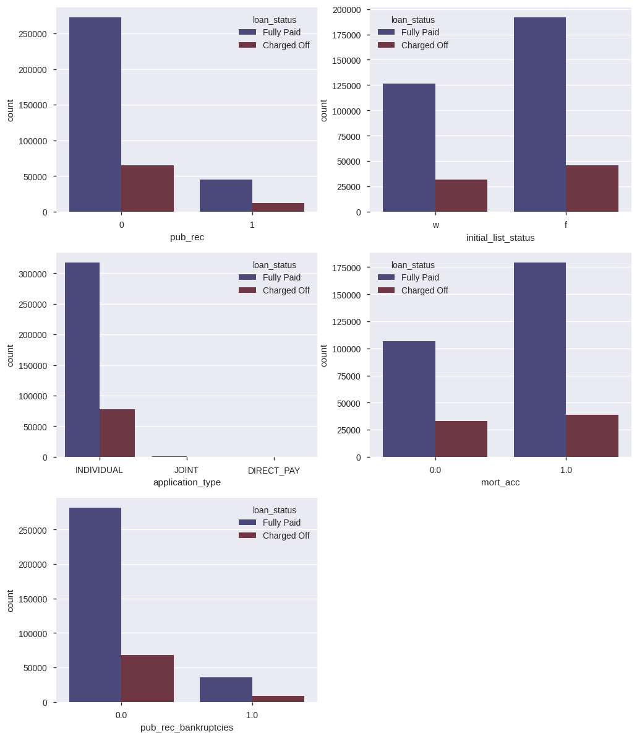
Exploratory Data Analysis
Insights
People with no derogatory public records have higher percentage of loan re-payment
People with fractional approval of loan are more likely to payback the loan

Slide 13
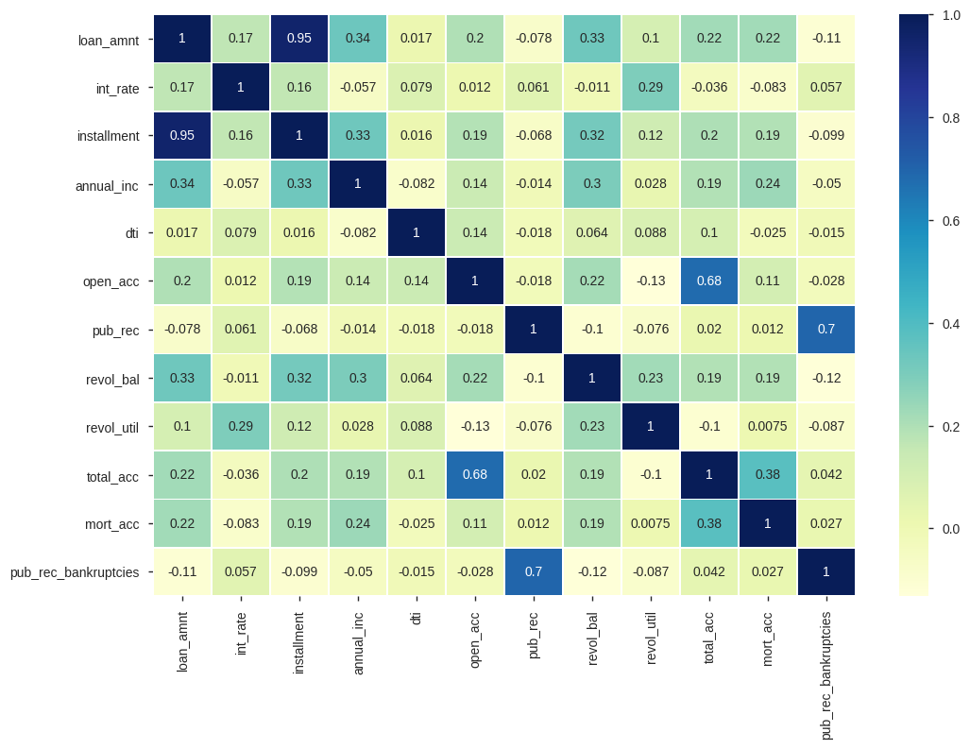
Exploratory Data Analysis
Insights
Most of the variables are mutually correlated
Strong correlation can be seen between loan amount and installments
Moderately strong correlation can be seen between open credit lines and total accounts
Slightly weaker correlation can be seen between mortgage accounts and total accounts

Slide 14
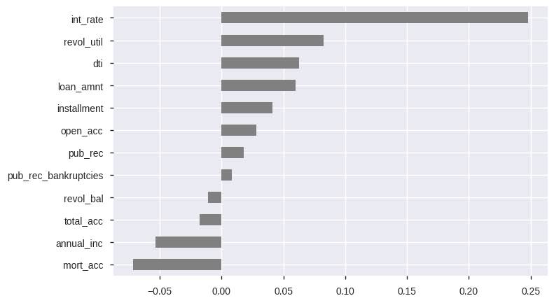
Exploratory Data Analysis
Insights
Interest rate is the strongest positive correlation with loan status
Whereas, mortgage accounts show the strongest negative correlation

Slide 15
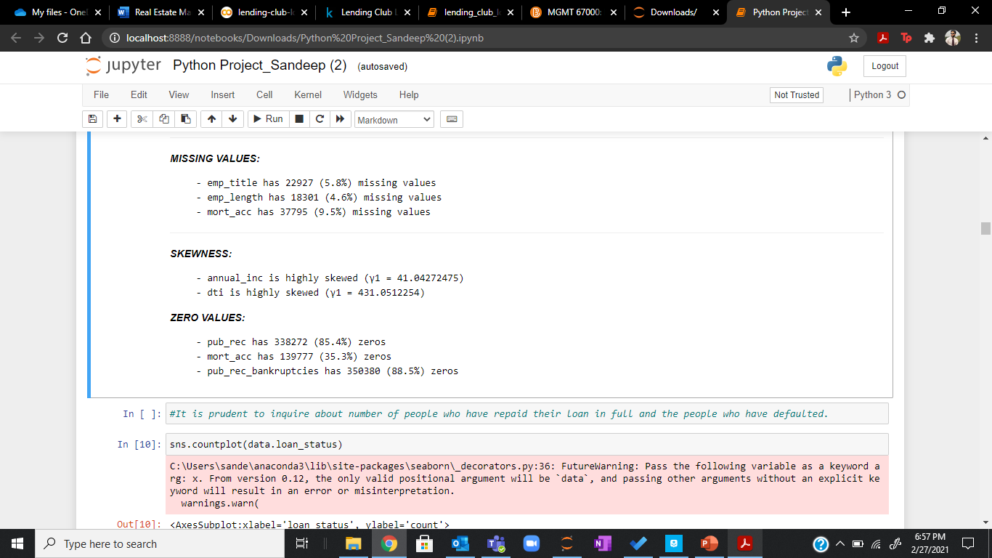
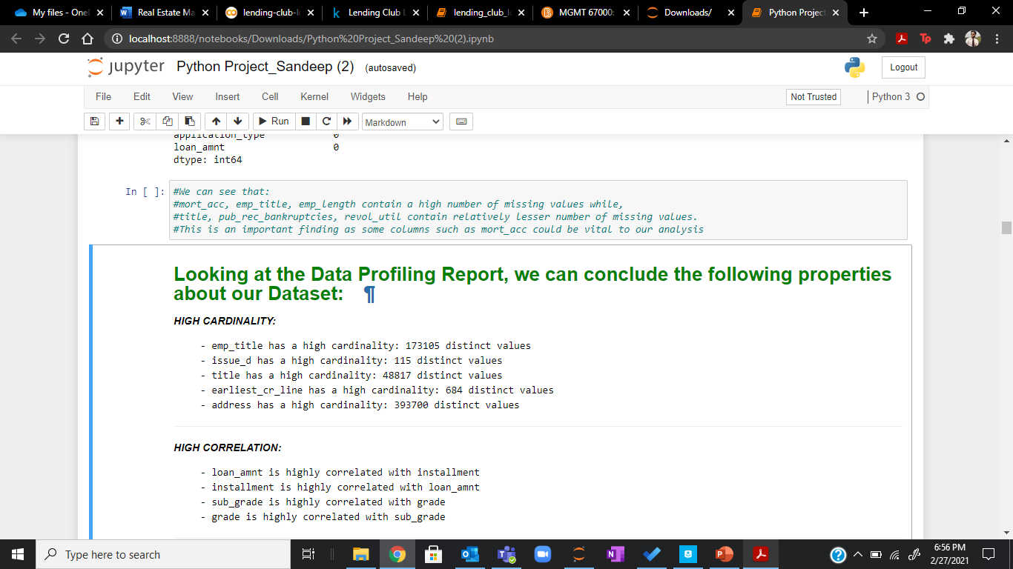
Exploratory Data Analysis
report = pp.ProfileReport(train)
display(report)

Slide 16



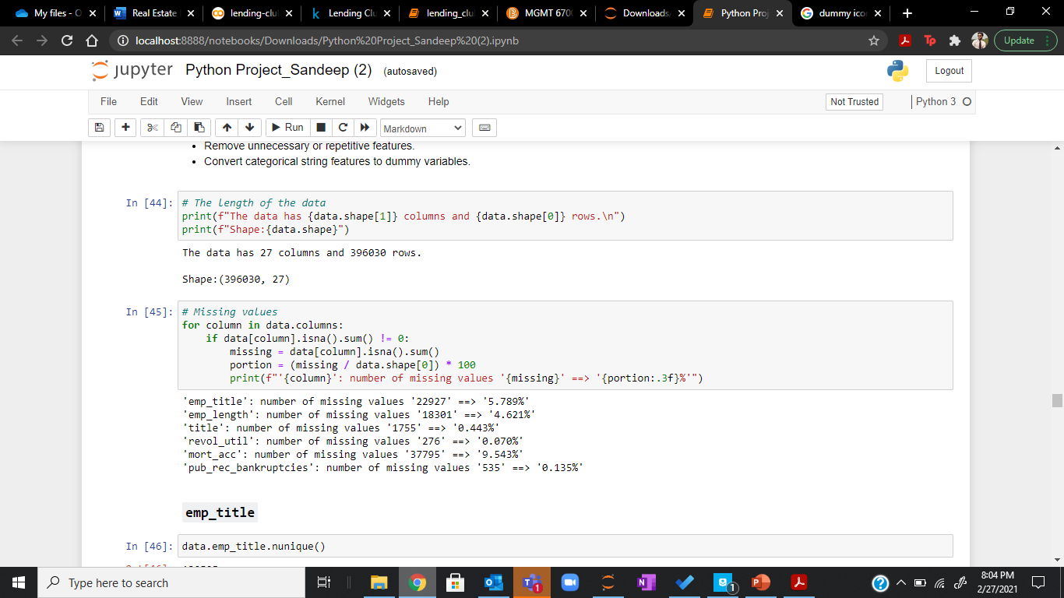
Data Pre-Processing
Data Cleaning Goals
Deal with missing data
Re-engineering Attributes
Convert to dummy variables

Slide 17
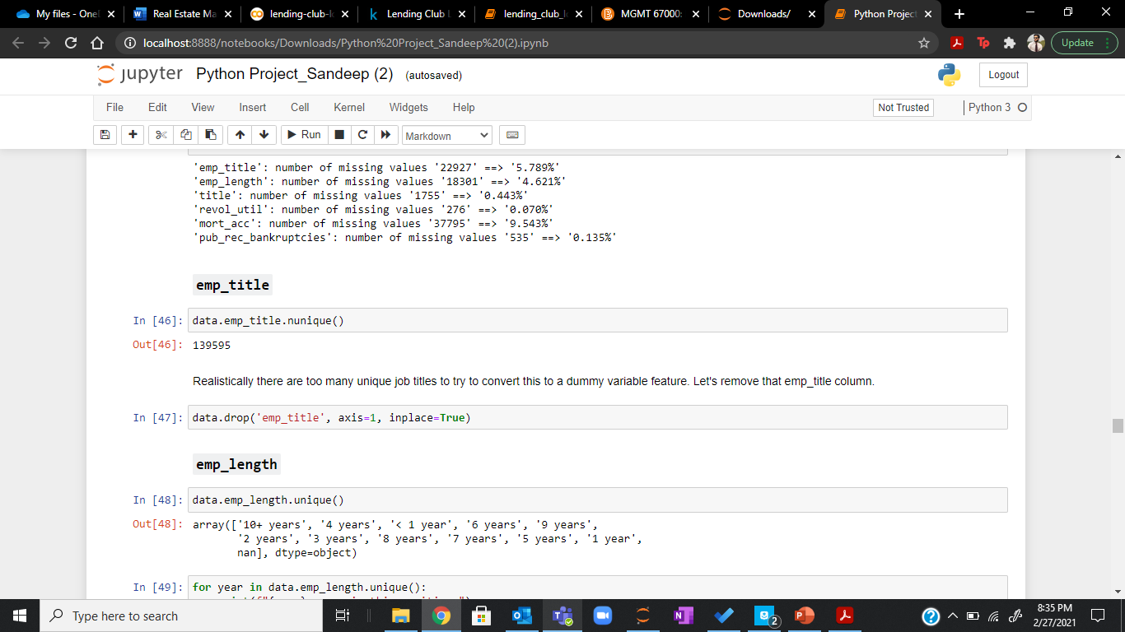
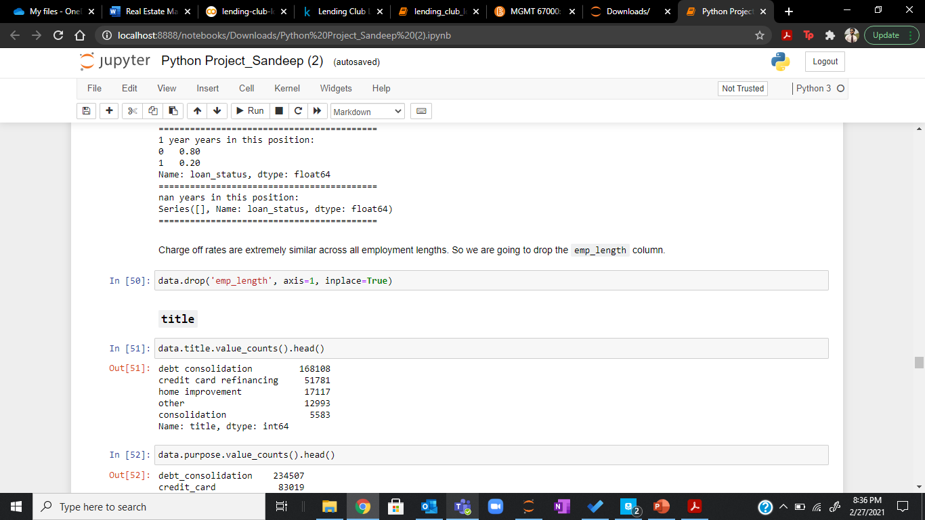

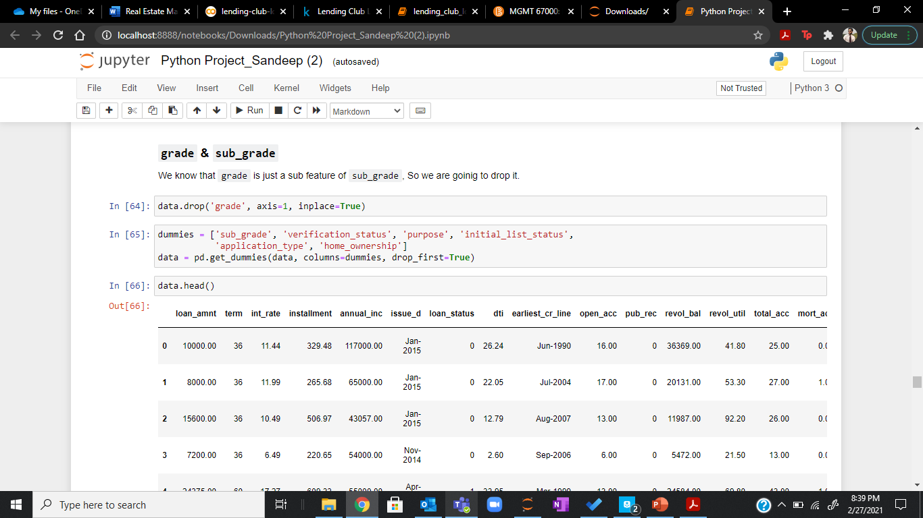
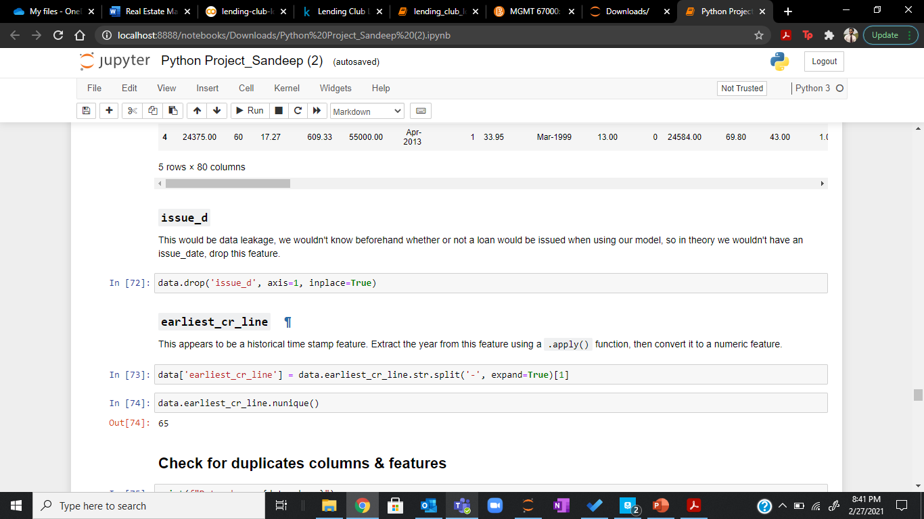
Data Pre-Processing
Below attributes were dropped from the model:
emp_title
emp_length
title
grade
issue_d

Slide 18
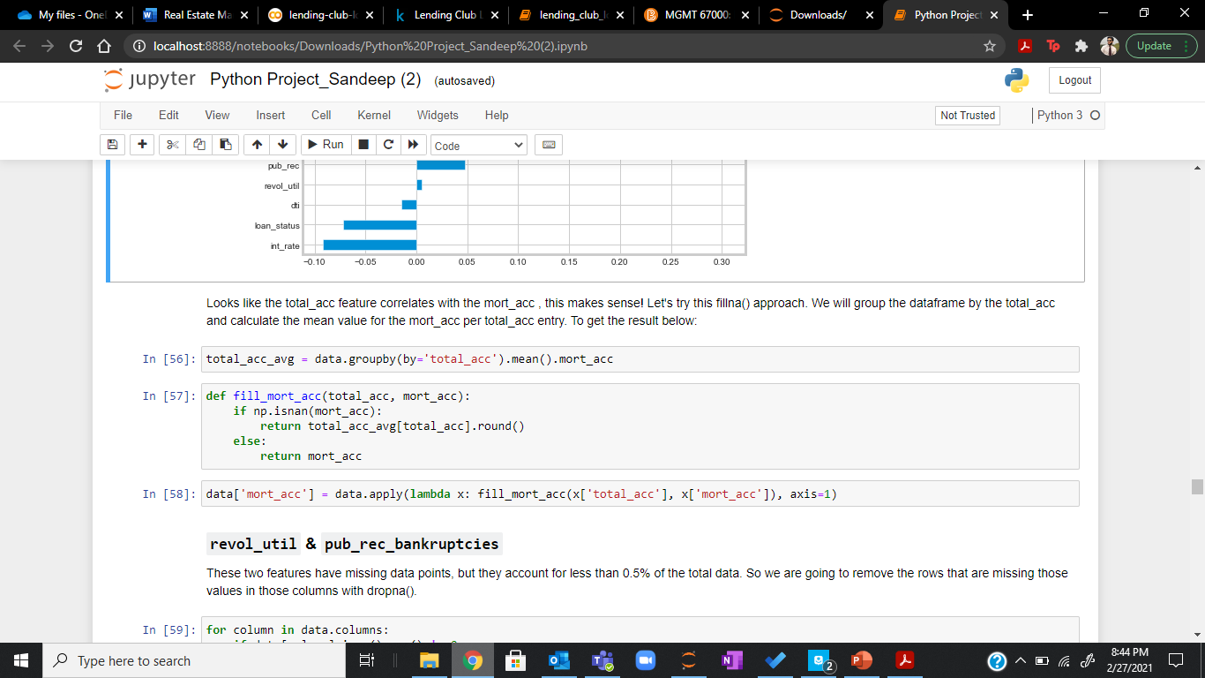
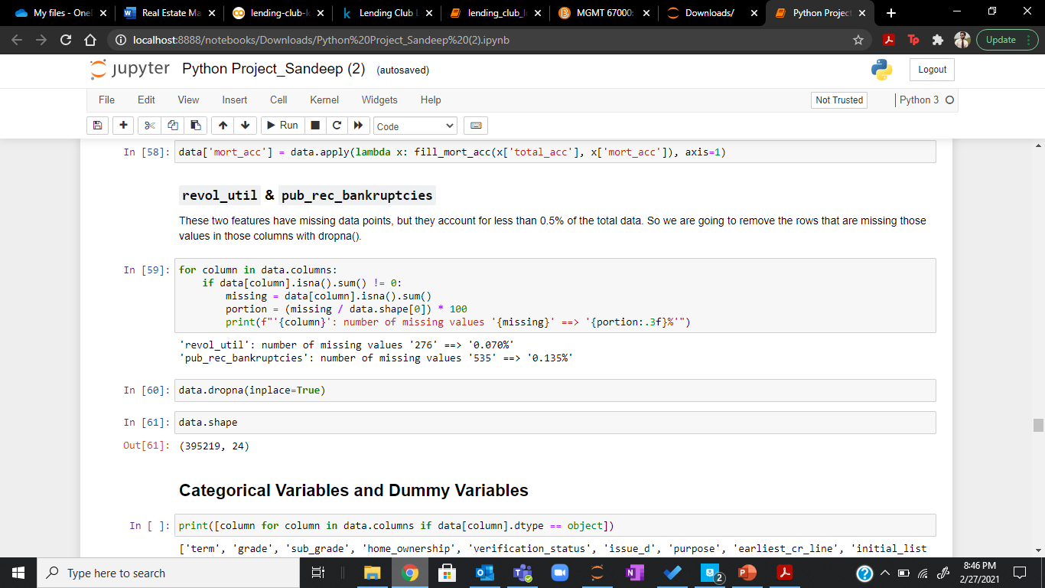
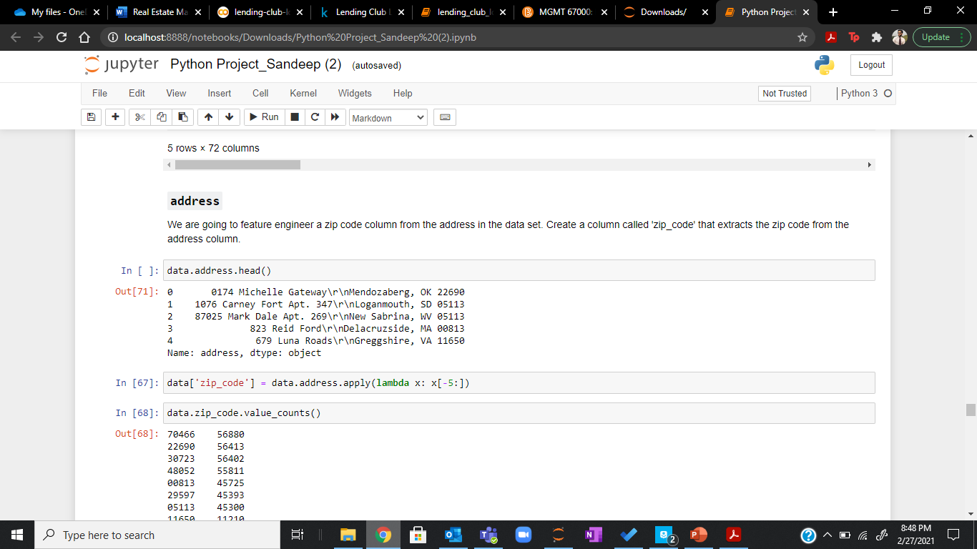
Data Pre-Processing
Below attributes were re-engineered from the model:
mort_acc
revol_util & pub_rec_bankruptcies
address

Slide 19
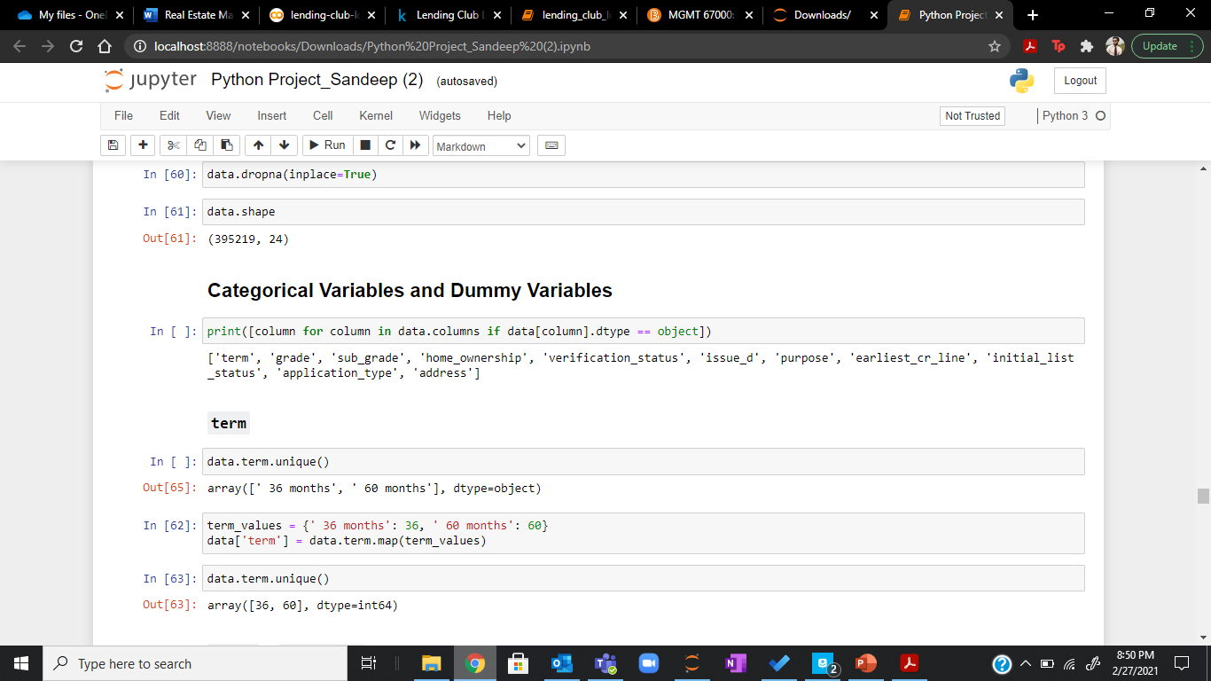
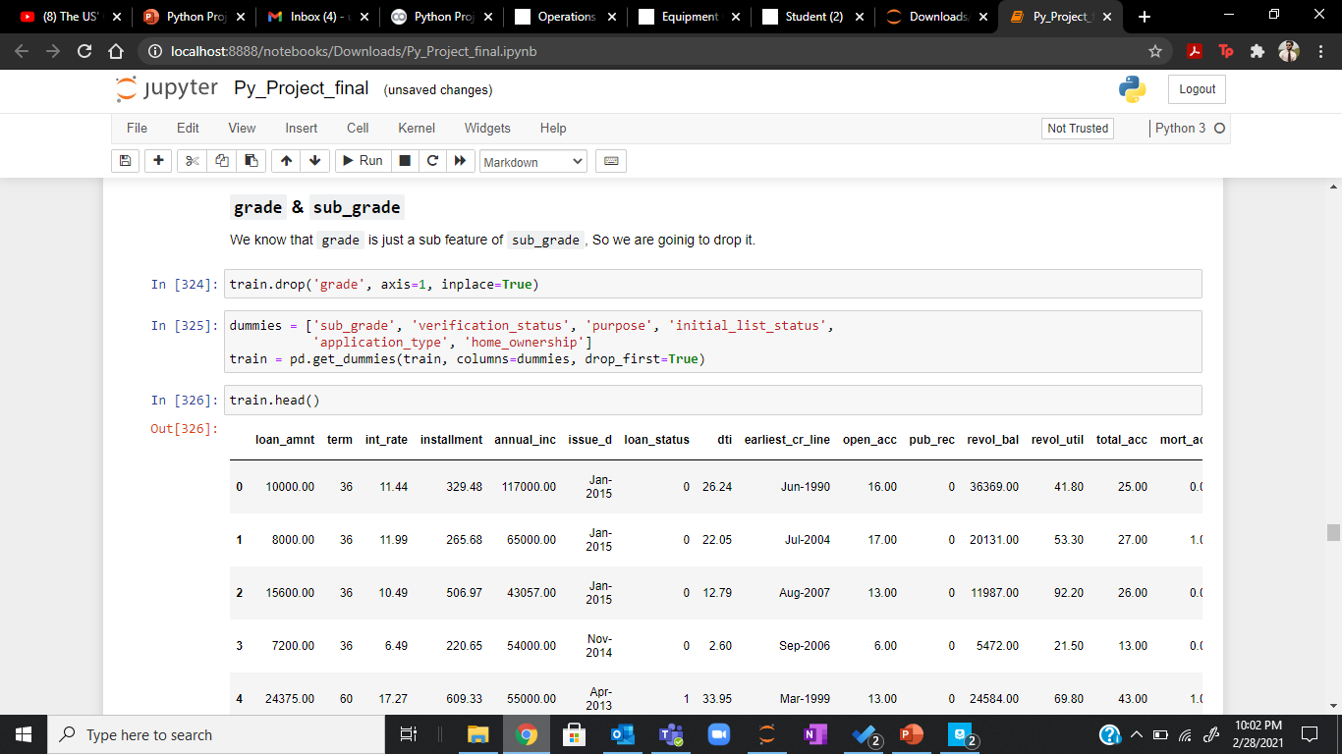
Data Pre-Processing
Converting to dummy variables:

Slide 20
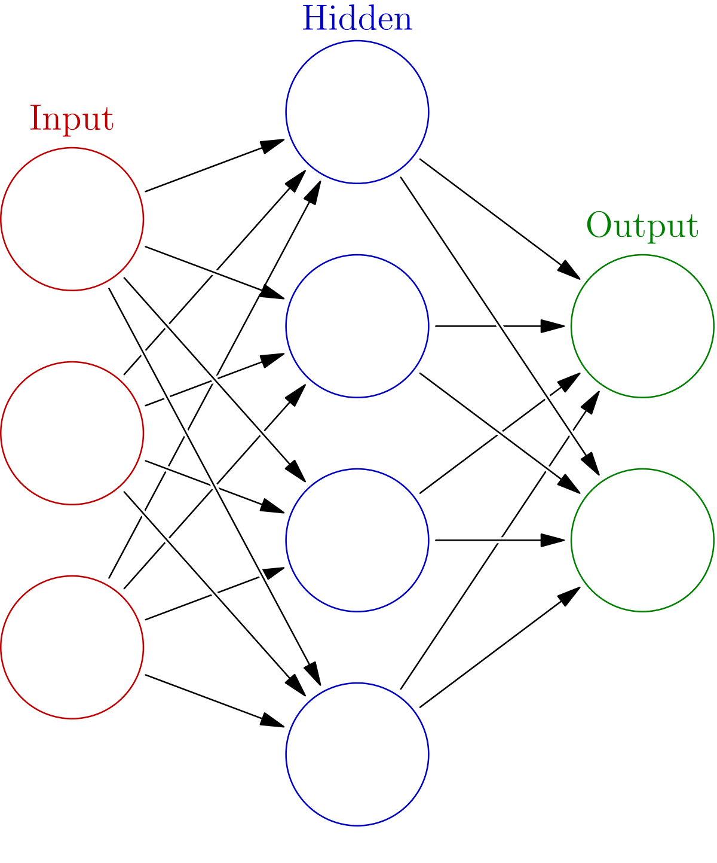
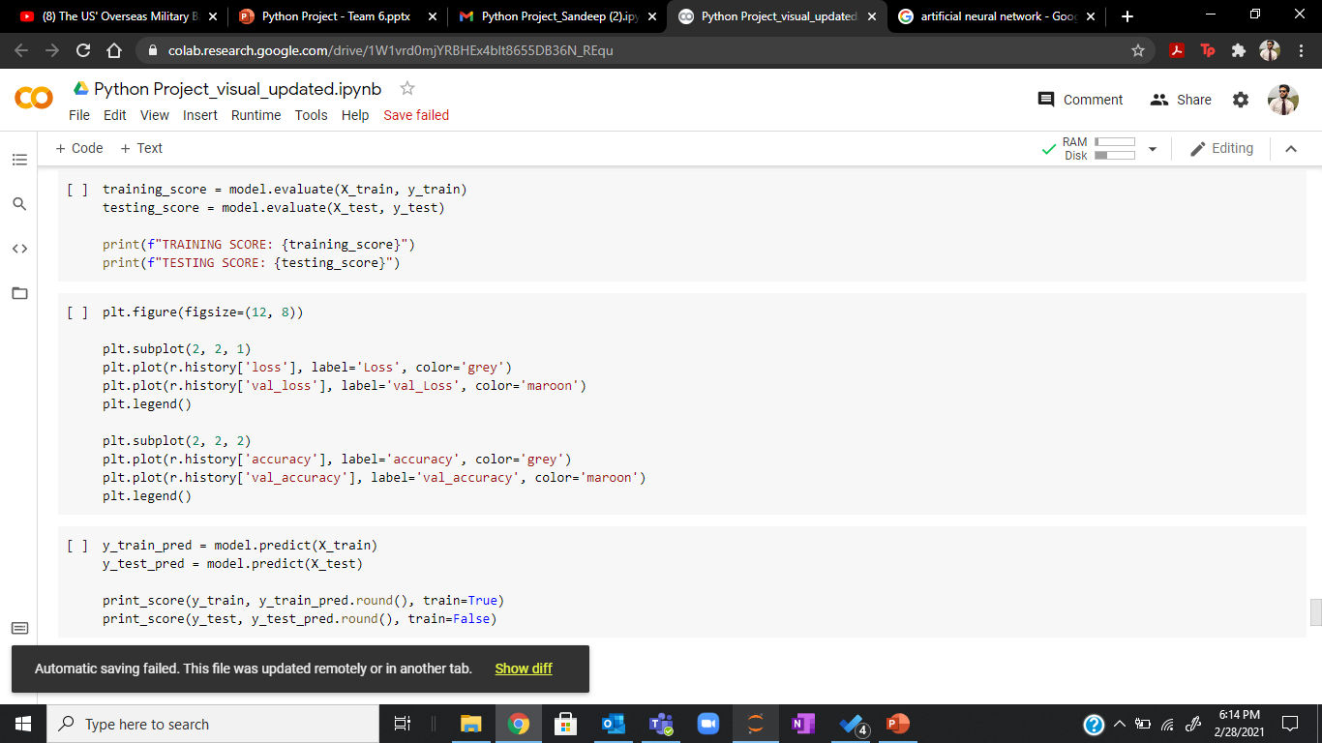
Model Building & Testing

Slide 21
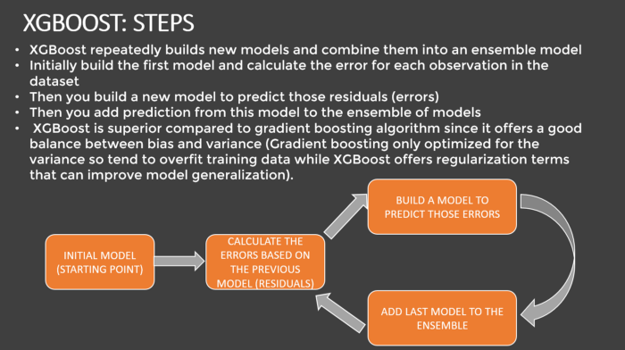
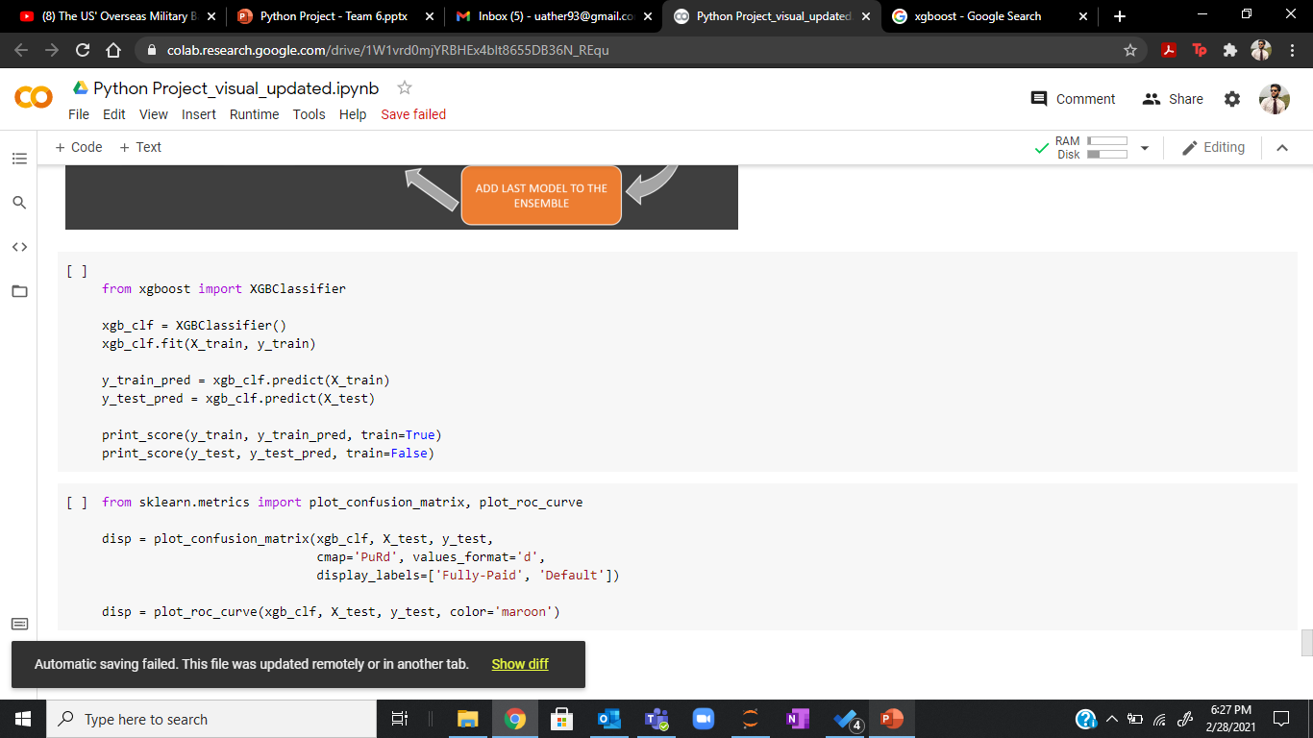
Model Building & Testing

Slide 22
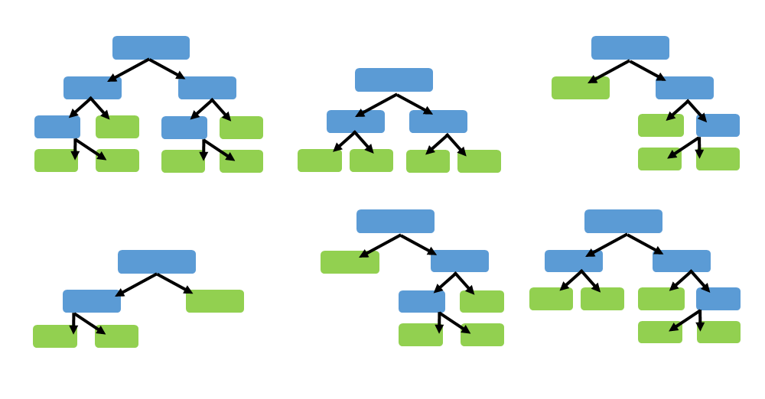
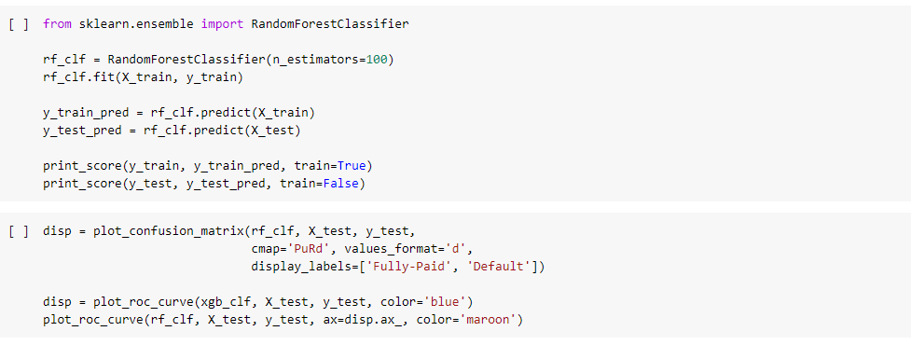
Model Building & Testing

Slide 23
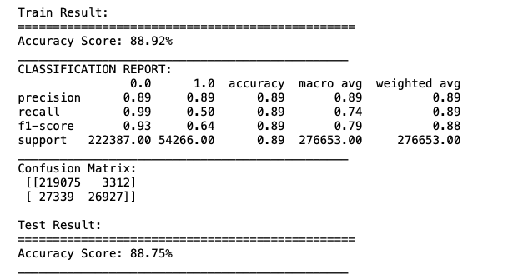
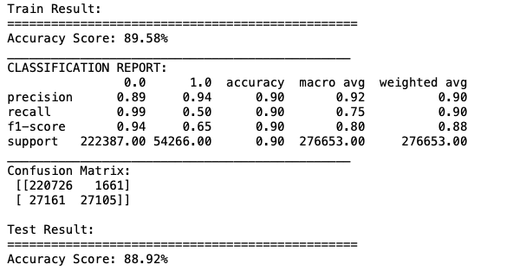
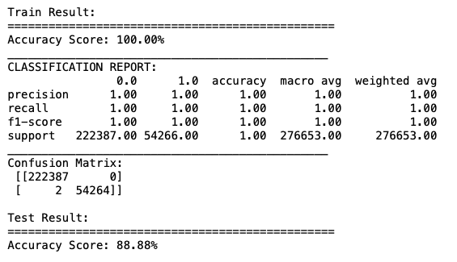
Comparing Models
ANNs
XGBoost
Random Forest

Slide 24
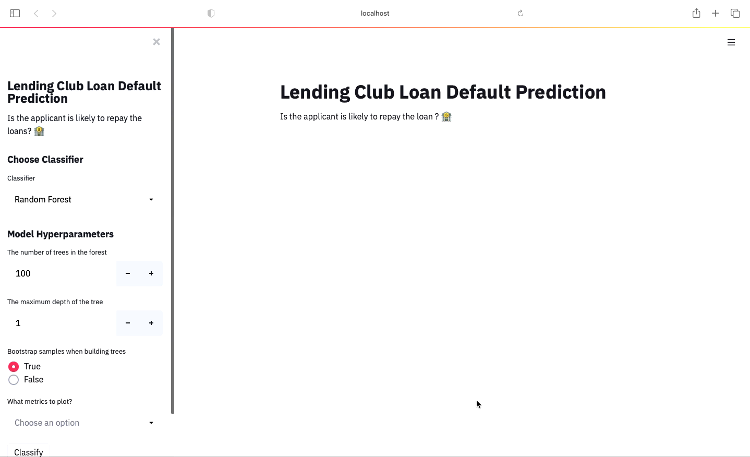
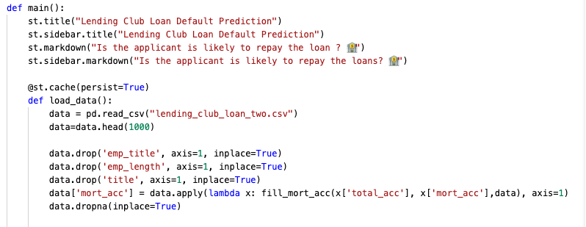
Dashboard Demo

Slide 25
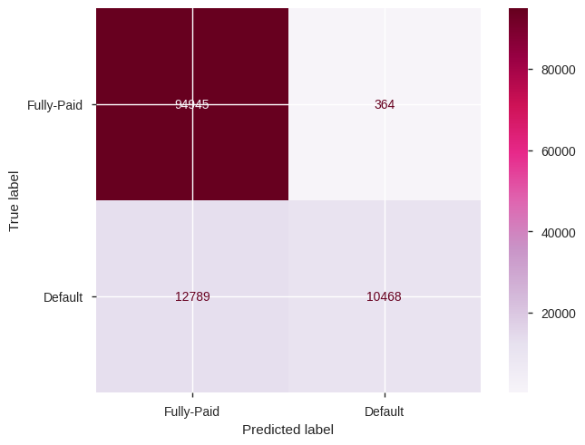
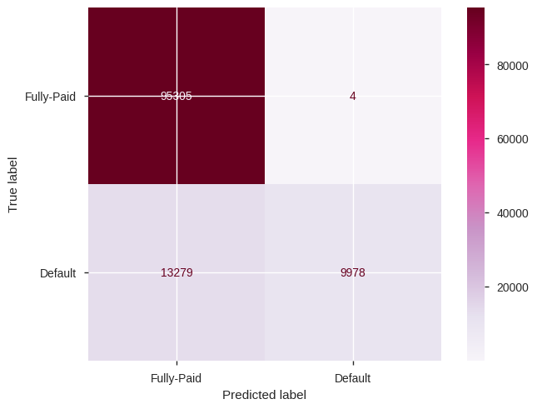
Comparing Models
Confusion Matrix for Random Forest
Confusion Matrix for XGBoost

Slide 26
Recommendations & Way Forward
1. More data points for loan defaulters (false positives) will help us classify them better
2. Further categorization amongst the loan defaulters will help us minimize the false negative which in turn will help us maximize profit
3. As per the linear measures of correlation between the predictors and the response, the most important variables for predicting loan defaulters are total mortgage accounts, annual income, installments and loan amount

Slide 27
Thank You!

